Slide 1
Ggplot2 and interactive graphics with R
Christophe Ladroue
SECTION 04
VIDEO 04
BigVis: visualizing big data
www.PacktPub.com

Slide 2
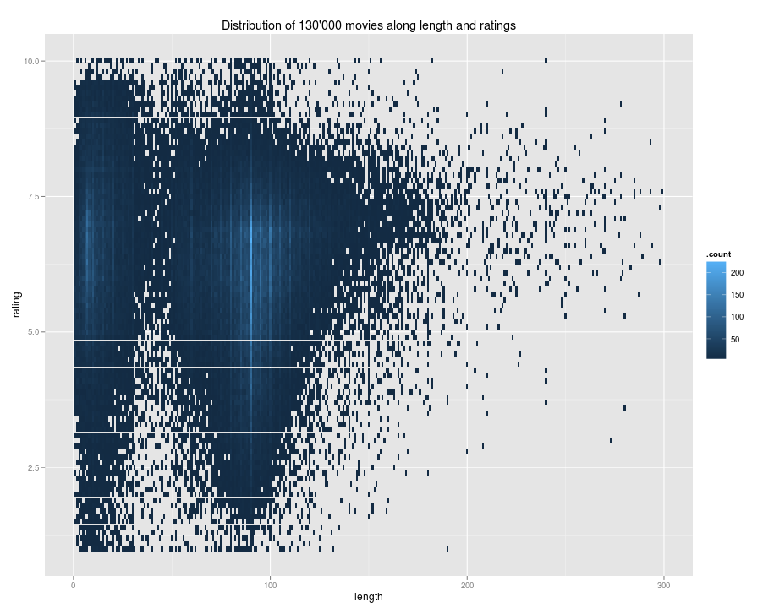

In this video we took a look at
how to install the package BigVis
how to quickly make plot from a large dataset.
Next: outliers and smoothing

